Slide 1
2. Nexus sound solutions
WATER AND FOOD AND ENERGY
Agrivoltaics with integrated Rainwater Harvesting
RE-driven Pump for irrigation
Saline Water Greenhouses
Canal top solar PVs
Water efficient cooling (ZLD-Cooling Towers)
Biogas (Energy out of solid waste and waste water)
Phosphorous and Nitrogen Recovery
WATER AND FOOD
Hydroponics
Irrigation
Mulching
ENERGY AND WATER
Hydropower
UV- or Ozone-Desinfection
Water and Electricity Cogeneration Systems
Renewable Desalination
Humidification-Dehumidification
Wastewater Treatment
Membrane Distillation
Solar Still
Floating PV
FOOD AND ENERGY
Bioenergy
Food Processing (Drying, Cooling, Cooking)
Food Storage
Residues
Composting (Fertilizer out of
organic waste residues)
WATER
Managed Aquifer Recharge
Rainwater Harvesting
Fog Harvesting
Constructed Wetlands
Water Storage Management (Tank, Retention Basin, Dam, Groundwater Aquifer, Soil)
Hydrocyclon
Inflotec (Waver und Greenfields)
ENERGY
Wind Turbines
Photovoltaics (PV)
Heat Pumps
Thermal Power Plant
Solar Thermal energy
FOOD
Harvesting
Agroforestry
Silviopasture (livestock)
Figure: Silvia Krautzik
Notes:
The smart combination of single-sector technologies allows to tap the synergies within the water energy and food nexus. Nexus smart solutions include agrivoltaics, water and electricity cogeneration systems, solar-powered irrigation systems (see examples), saline water greenhouses (Al-Ismaili and Jayasuriya, 2016), water efficient cooling towers (Pan et al. 2018), recycling of solid waste and wastewater for energy supply (Wang et al., 2017) and fertilization (González-Sierra et al., 2019), and phosphorous and nitrogen recovery (Chrispim et al. 2019, Robles et al. 2020).
Water-Energy-Food Nexus Sound Solutions (WEF-NSS)
All kind of solutions which address WEF nexus challenge and increase resource use efficiency across sectors by tapping synergies and/or minimizing trade-offs. WEF NSS include technology-based systems, nature-based systems, hybrid systems. The systems can encompass multiple sectors or act only in a single sector while indirectly affecting other sectors (e.g., smart irrigation system). Further, WEF NSS comprise policies, cross-sector coordination instruments, and integrated resource management strategies. The cross-sector efficiency gains can occur at all points of the system processes (source, transformation/conversion, storage, end-use) or can also be induced through the solution (policy, the establishment of cross-sector coordination, integrated resource management).
WEF Polyservice Systems
WEF polyservice system refers to cross-sector technology-, nature-based, and hybrid systems addressing WEF nexus challenges. They interlink at least two sectors and tap direct and indirect synergistic effects across sectors.
WEF Polygeneration/Polyproduction Systems
The term is inspired by the energy sector (e.g., heat and power cogeneration) and expresses the system's variety of provided end-uses. The term "polygeneration" indicates that the system produces at least two commodities for end-use in different sectors (e.g., Agrophotovoltaics: Electricity and Crops).
––––––––––––––––
References
Al-Ismaili, A. M., & Jayasuriya, H. (2016). Seawater greenhouse in Oman: A sustainable technique for freshwater conservation and production. Renewable and Sustainable Energy Reviews, 54, 653–664. https://doi.org/10.1016/j.rser.2015.10.016
Chrispim, M. C., Scholz, M., & Nolasco, M. A. (2019). Phosphorus recovery from municipal wastewater treatment: Critical review of challenges and opportunities for developing countries. Journal of Environmental Management, 248, 109268. https://doi.org/10.1016/j.jenvman.2019.109268
González-Sierra, R. P., Arrizmediarrieta, J. S., Sánchez, B. P., Iriate, I. I., & Duarte, G. N. (2019). Community Composting: A Practical Guide for Local Management of BIowaste.
Pan, S.‑Y., Snyder, S. W., Packman, A. I., Lin, Y. J., & Chiang, P.‑C. (2018). Cooling water use in thermoelectric power generation and its associated challenges for addressing water-energy nexus. Water-Energy Nexus, 1(1), 26–41. https://doi.org/10.1016/j.wen.2018.04.002
Robles, Á., Aguado, D., Barat, R., Borrás, L., Bouzas, A., Giménez, J. B., . . . Seco, A. (2020). New frontiers from removal to recycling of nitrogen and phosphorus from wastewater in the Circular Economy. Bioresource Technology, 300, 122673. https://doi.org/10.1016/j.biortech.2019.122673
Wang, X., Guo, M., van Dam, K. H., Koppelaar, R. H.E.M., Triantafyllidis, C., & Shah, N. (2017). Waste-Energy-Water systems in sustainable city development using the resilience.io platform. In Computer Aided Chemical Engineering. 27th European Symposium on Computer Aided Process Engineering (Vol. 40, pp. 2377–2382). Elsevier. https://doi.org/10.1016/B978-0-444-63965-3.50398-6

Slide 2
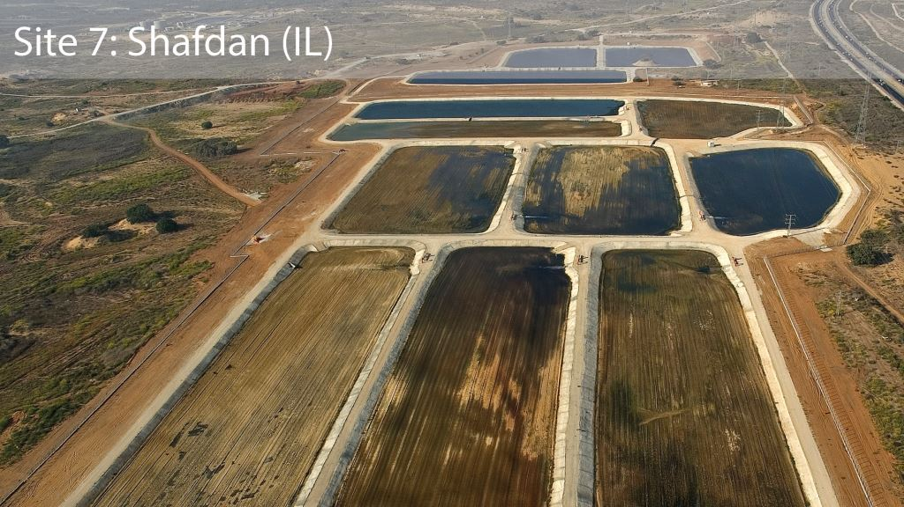
What is Managed Aquifer Recharge (MAR)?
© Albatross / Mekorot http://aquanes.eu/Uploads/Img/site-no-07.jpg
Notes:
What is MAR?
Managed aquifer recharge (MAR) is a technique used to recharge water to aquifers intentionally. Put simply, one can say that MAR is a practice that increases the amount of water that enters a groundwater reservoir. Managed groundwater recharge is done by storing water in basins, furrows, or other structures that allow surface water to infiltrate into the soil and recharge aquifers (Bouwer et al., 2002). The picture above shows what these MAR sites look like. The picture shows the Shafdan wastewater treatment plant in the South of Tel Aviv, Israel. However, the Shafdan site is more than just a simple treatment plant. It is a full-scale water reuse scheme that features infrastructures for managed aquifer recharge. Using a biological treatment process, the Shafran plant treats wastewater from the Greater Tel Aviv metropolitan area. Afterward, the operators of Shafdan infiltrate the secondary treated effluent into aquifers via large basins. You can see these basins in the picture; some are already filled with water. The infiltrated water is re-abstracted from the aquifers after 6-12 months and is used for irrigation (AquaNes, 2016).
Terminology
Note that sometimes the terms „enhanced recharge”, “water banking”, and “sustainable underground storage” are used to refer to MAR. In many cases MAR is also called „artificial aquifer recharge“. The latter has been replaced by „MAR“ because of the negative connotation of the word „artificial“. It somewhat implied that the water recharge was unnatural even though MAR is based on natural processes. One key reason for using the new terminology „MAR“ was the involvement of society in water resources management. As community participation in water management decisions becomes more important, the term „artificial aquifer recharge“ might be misleading (Dillon, 2005).
Categories of aquifer recharge
MAR can happen intentionally or unintentionally. Depending on several human activities that enhance aquifer recharge, three categories are considered:
Unintentional recharge: Recharge might happen due to land clearing, irrigated areas, or based on leaks from stormwater drains and sewers in urban areas.
Unmanaged recharge: Recharge occurs due to stormwater drainage wells. The intention behind these activities is the disposal of the water without further reuse. Another example would be septic tanks that leach fields.
Managed recharge: Recharge happens through built and planned recharge structures. These recharge structures are designed for water recovery and water storage to provide environmental benefits (NRMMC–EPHC–NHMRC, 2009; Page et al., 2018). For instance, the infiltration basins on the picture above fall under this category.
––––––––––––––––
References
AquaNes (2016): Demonstration site. Available at: http://aquanes.eu/Default.aspx?t=1673 (accessed 25/11/2021).
Bouwer, H. Artificial recharge of groundwater: hydrogeology and engineering. Hydrogeology Journal 10, 121–142 (2002). https://doi.org/10.1007/s10040-001-0182-4
Dillon, P. Future management of aquifer recharge. Hydrogeol J 13, 313–316 (2005). https://doi.org/10.1007/s10040-004-0413-6
Page, D., Bekele, E., Vanderzalm, J., & Sidhu, J. (2018). Managed Aquifer Recharge (MAR) in Sustainable Urban Water Management. Water, 10(3), 239. https://doi.org/10.3390/w10030239

Slide 3
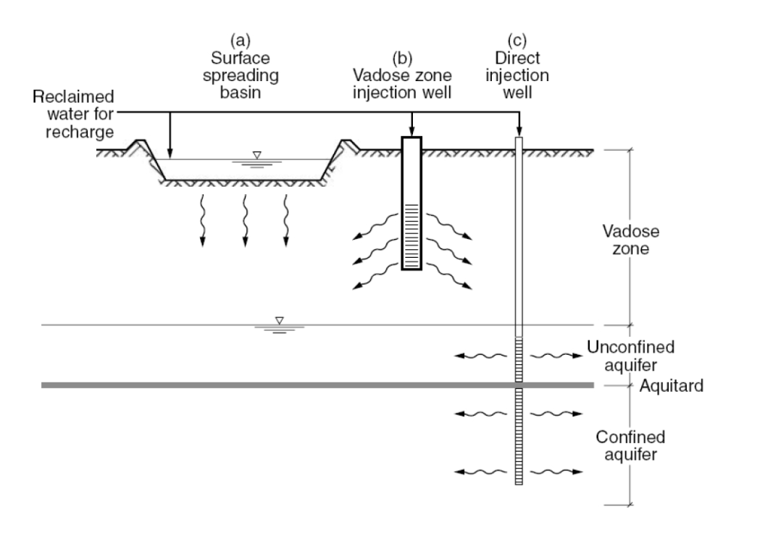
Overview of MAR schemes
term for treated sewage = recycled water
Confined aquifers might require different MAR schemes than unconfinded aquifers.
Source: NRMMC–EPHC –NHMRC, 2009.
Notes:
Overview of MAR schemes
A wide range of methods and technical designs are available for recharging water into the ground. The MAR technologies range from low-tech to more advanced ones. Hence, it is better to understand “MAR” as an umbrella term for different kind of recharge methods. The different methods depend on different conditions such as hydrogeological conditions, aquifer characteristics, and water quality (Page et al. 2018). The figure above shows the implementation of MAR for different scenarios.
Surface Spreading System—Infiltration Basins
Surface spreading basins are a simple method of MAR. Different kinds of water such as stormwater, river water or treated wastewater are stored on the land surface or impounded in infiltration basins or modified stream channels. Usually the water table is below the land surface and the water from the basin infiltrates through the unsaturated zone. Surface Spreading basins are often used to recharge shallow unconfined aquifers (Maliva, 2019).
(b) Vadose zone injection wells (VZW) The vadose zone injection wells are also called dry wells or recharge shafts. VZWs are shallow wells that are commonly used when groundwater tables are relatively deep. This technique is particularly relevant when implementing MAR schemes in semiarid or arid regions where groundwater tables very deep (i.e. 100 to 300m or more). Additionally, VZWs are preferred on sites where permeable soils are not available. The VZWs allow infiltration of water through the unsaturated zone to unconfined aquifers at deeper levels (NRMMC–EPHC–NHMRC, 2009; Liang, et al., 2018).
Infiltrating water through the vadose zone offers a range of benefits. For instance, the water infiltration might lead to improved water quality via biological, chemical and physical processes before reaching the aquifer (Liang, et al., 2018).
(c) Direct Injection Wells Direct injection wells are widely used across the globe. This method injects water into an aquifer where the water is stored over a defined period. The storage period is followed by a period of water recovery. This means that the aquifer’s recharged water is pumped from the same well for further use (Casanova, 2016). In general, this method is suitable to recharge confined as well as unconfined aquifers (NRMMC–EPHC–NHMRC, 2009).
––––––––––––––––
References
Casanova J., Devau N., Pettenati M. (2016) Managed Aquifer Recharge: An Overview of Issues and Options. In: Jakeman A.J., Barreteau O., Hunt R.J., Rinaudo JD., Ross A. (eds) Integrated Groundwater Management. Springer, Cham. https://doi.org/10.1007/978-3-319-23576-9_16
Liang, X., Zhan, H., & Zhang, Y.-K. (2018). Aquifer Recharge Using a Vadose Zone Infiltration Well. Water Resources Research. doi:10.1029/2018wr023409
Maliva, R. G. (2019). Surface Spreading System—Infiltration Basins. SpringerBriefs in Electrical and Computer Engineering, 469–515. doi:10.1007/978-3-030-11084-0_15
NRMMC–EPHC–NHMRC (2009): Australian Guidelines for Water Recycling, Managing Health and Environmental Risks, Volume 2C—Managed Aquifer Recharge. Natural Resource Management Ministerial Council, Environment Protection and Heritage Council National Health and Medical Research Council. Available at: http://www.ephc.gov.au/ taxonomy/term/39 (accessed: 11/09/2021).

Slide 4
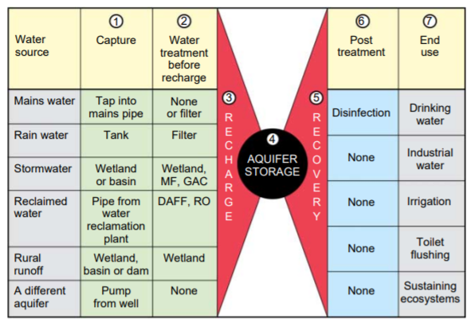
7 key elements of MAR schemes
Source: Dillon et al., 2010
Notes:
How does MAR work? – The 7 key elements MAR describes different recharge techniques that allow reclaimed water to infiltrate into aquifers for groundwater recovery or environmental benefit (Sprenger et al., 2017; Page et al., 2018; Salameh et al., 2019). The figure above shows typical sources of water and the methods of capture, pre-treatment, and post-treatment of water for managed aquifer recharge. The circled numbers in the figure show the seven standard elements of a managed aquifer recharge system: (1) water capture, (2) pre-treatment, (3) recharge, (4) storage, (5) recovery, (6) post-treatment, and (7) end-use (NRMMC–EPHC–NHMRC 2009; Dillon et al., 2010).
––––––––––––––––
References
Dillon, P., Toze, S., Page, D., Vanderzalm, J., Bekele, E., Sidhu, J., & Rinck-Pfeiffer, S. (2010). Managed aquifer recharge: rediscovering nature as a leading edge technology. Water Science and Technology, 62(10), 2338–2345. doi:10.2166/wst.2010.444
Dillon, P., Stuyfzand, P., Grischek, T., Lluria, M., Pyne, R. D. G., Jain, R. C., Sapiano, M. (2018). Sixty years of global progress in managed aquifer recharge. Hydrogeology Journal. doi:10.1007/s10040-018-1841-z
NRMMC–EPHC–NHMRC (2009): Australian Guidelines for Water Recycling, Managing Health and Environmental Risks, Volume 2C—Managed Aquifer Recharge. Natural Resource Management Ministerial Council, Environment Protection and Heritage Council National Health and Medical Research Council. Available at: http://www.ephc.gov.au/ taxonomy/term/39 (accessed: 11/09/2021).
Page, D., Bekele, E., Vanderzalm, J., & Sidhu, J. (2018). Managed Aquifer Recharge (MAR) in Sustainable Urban Water Management. Water, 10(3), 239. doi:10.3390/w10030239
Salameh, E., Abdallat, G., & van der Valk, M. (2019). Planning Considerations of Managed Aquifer Recharge (MAR) Projects in Jordan. Water, 11(2), 182. doi:10.3390/w11020182
Sprenger, C.; Hartog, N.; Hernández, M.; Vilanova, M.; Grützmacher, G.; Scheibler, F.; Hannappel, S. (2017): Inventory of managed aquifer recharge sites in Europe: Historical development, current situation and perspectives. Hydrogeological Journal, 25, 1909-2345. doi: 10.1007/s10040-017-1554-8

Slide 5
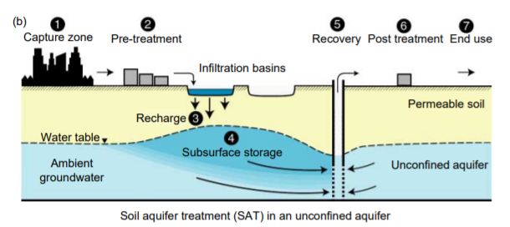
Example: Soil aquifer treatment (SAT)
Source: NRMMC–EPHC –NHMRC, 2009.
Notes:
Example: Soil aquifer treatment (SAT)
A more detailed example showing the 7 key elements or MAR schemes can be found in this section. The figure above shows a MAR system known as soil aquifer treatment (SAT) that infiltrates water into an unconfined aquifer. SAT is often used to enter stormwater or pre-treated wastewater (2) through an infiltration basin. As the sewage effluent moves through the soil and aquifer, nutrient and pathogen removal is facilitated and the quality of the effluent improves. The water is then stored in the underlying aquifer (3-4). The water can now be reused (5) for different purposes such as irrigation, industrial use, drinking water or discharge into ecosystems. Depending on the end-use the water will require post-treatment (6) before it is distributed to its users (NRMMC–EPHC –NHMRC, 2009; Dillon et al., 2010).
For instance, the Shafdan site in Israel uses SAT to improve the water quality.
Summary and Overview of MAR schemes for implementation
SAT is just one of man MAR methods. Other types of MAR systems are listed below (NRMMC–EPHC –NHMRC, 2009): 1. Aquifer storage and recovery (ASR)
2. Aquifer storage, transport and recovery (ASTR)
3. Vadose zone wells
4. Percolation tanks and recharge weirs
5. Rainwater harvesting
6. Bank filtration
7. Infiltration galleries
8. Dune filtration
9. Infiltration ponds
10. Soil aquifer treatment
11. Underground dams
12. Sand dams
13. Recharge releases
––––––––––––––––
References
Dillon, P., Toze, S., Page, D., Vanderzalm, J., Bekele, E., Sidhu, J., & Rinck-Pfeiffer, S. (2010). Managed aquifer recharge: rediscovering nature as a leading edge technology. Water Science and Technology, 62(10), 2338–2345. doi:10.2166/wst.2010.444
NRMMC–EPHC–NHMRC (2009): Australian Guidelines for Water Recycling, Managing Health and Environmental Risks, Volume 2C—Managed Aquifer Recharge. Natural Resource Management Ministerial Council, Environment Protection and Heritage Council National Health and Medical Research Council. Available at: http://www.ephc.gov.au/ taxonomy/term/39 (accessed: 11/09/2021).
Page, D., Bekele, E., Vanderzalm, J., & Sidhu, J. (2018). Managed Aquifer Recharge (MAR) in Sustainable Urban Water Management. Water, 10(3), 239. doi:10.3390/w10030239

Slide 6
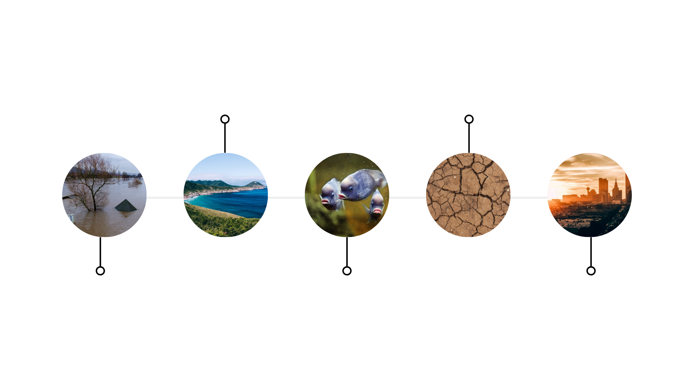
Benefits of MAR
Prevention of
salt-water intrusion
Drought
resilience
Flood risk
management
Aquatic ecosystem
restoration
Integration into
urban water projects
Notes:
When to use MAR? Groundwater overexploitation has rapidly increased over the past decades due to electricity distribution for water pumping, population growth in urban areas, and the need for increased food production. In the first place, MAR is a solution that can enhance the quantity and quality of groundwater in different regions (Dillon et al., 2018). At the same time, MAR offers additional benefits.
What are the benefits of MAR?
Flood risk management: Floodwater can be used for recharge and combined with surface storage to dampen the flood peak.
Salt-water intrusion prevention: MAR can stabilize or recover ground water levels in overexploited aquifers. Replenishment of coastal aquifers can provide additional water supply while preventing saltwater intrusion. One successful example is the MAR scheme in the Burdekin Delta. Groundwater resources in the Delta are located at shallow depths and the groundwater itself is used for sugar cane and crop production. MAR is used to maintain high watertables which prevent the saltwater to migrate further inland (Charlesworth et al., 2002).
Aquatic ecosystem restoration: MAR can benefit aquatic ecosystem restoration whenever stored groundwater is discharged to help maintain environmental flows requirements.
Droughts: MAR can help build drought resilience by providing a storage for multiyear droughts without losses due to evaporation
Multi-purpose projects: MAR can be integrated in urban water projects, combining wastewater reuse or wetland restoration.
––––––––––––––––
References
Charlesworth PB, Narayan KA, Bristow KL, Lowis B, Laidlow G and McGowan R (2002). The Burdekin Delta — Australia’s oldest artificial recharge scheme. In: Management of Aquifer Recharge for Sustainability, PJ Dillon (ed.), Proceedings of the 4th International Symposium on Artificial Recharge (ISAR4), Adelaide, 22–26 September 2002, Swets and Zeitlinger, Lisse, pp. 347–352.
Dillon, P., Stuyfzand, P., Grischek, T., Lluria, M., Pyne, R. D. G., Jain, R. C., Sapiano, M. (2018). Sixty years of global progress in managed aquifer recharge. Hydrogeology Journal. doi:10.1007/s10040-018-1841-z
USACE-IWR (2020): Managed Aquifer Recharge: Water Security through Resilience. 2020-WP-01. April 2020. Available at: https://aquadoc.typepad.com/files/usace_mar_2020april.pdf?mc_cid=85ce7c0431&mc_eid=ffff8e049e

Slide 7
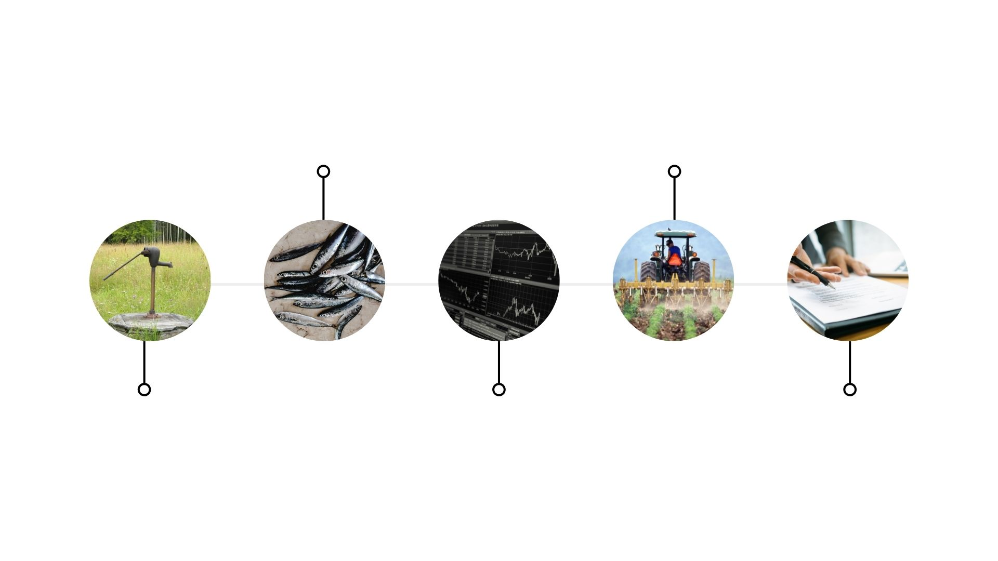
Challenges of MAR
Pollution risks/ health risks
Water
allocation
Clogging of wells/basins
Required
monitoring
Policies and governance
Notes:
1) Clogging is one of the most common and severe issues when operating a MAR scheme. Clogging means that the permeability of a porous medium is reduced. As a result, clogging causes a decrease in the recharge rate (NRMMC–EPHC–NHMRC, 2009). For example, in a Soil Aquifer Treatment (SAT) system, a clogging layer could create waterlogged conditions for nearby crops (Grinshpan et al., 2021).
2) Mismanagement of MAR schemes related to the infiltration of source water with poor quality can create high risks for public health and the environment. Hence, operational monitoring of hazards in a MAR scheme is essential for managing human and environmental health risks (NRMMC–EPHC–NHMRC, 2009). 3) MAR schemes require monitoring. However, monitoring can become a barrier for small-scale projects since it imposes high costs. Moreover, in some cases, water quality monitoring might not work due to the lack of sampling equipment or nearby laboratories (Page et al., 2020). 4) When implementing MAR, groundwater allocation plans and groundwater entitlements have to be considered to avoid potential use conflicts (NRMMC–EPHC–NHMRC, 2009). 5) Policies and local guidelines are required to ensure that MAR does not threaten human and environmental health. However, these kinds of policies are still lacking in many countries. The Australian national guidelines for MAR are the only national guidelines that align with the WHO’s water safety plan approach and govern the protection of human environmental health. Besides, a lack of regulatory frameworks also causes uncertainty when implementing MAR since proponents of a MAR scheme do not know if a scheme will be approved or not (Page et al., 2020).
––––––––––––––––
References Alam, S., Borthakur, A., Ravi, S., Gebremichael, M., & Mohanty, S. K. (2021). Managed aquifer recharge implementation criteria to achieve water sustainability. Science of The Total Environment, 768, 144992. doi:10.1016/j.scitotenv.2021.144992
NRMMC–EPHC–NHMRC (2009): Australian Guidelines for Water Recycling, Managing Health and Environmental Risks, Volume 2C—Managed Aquifer Recharge. Natural Resource Management Ministerial Council, Environment Protection and Heritage Council National Health and Medical Research Council. Available at: http://www.ephc.gov.au/ taxonomy/term/39 (accessed: 11/09/2021).
Grinshpan, M., Furman, A., Dahlke, H. E., Raveh, E., & Weisbrod, N. (2021). From managed aquifer recharge to soil aquifer treatment on agricultural soils: Concepts and challenges. Agricultural Water Management, 255, 106991. doi:10.1016/j.agwat.2021.106991
Page, D., Gonzalez, D., Bennison, G., Burrull, C., Claro, E., Jara, M., & Valenzuela, G. (2020). Progress in the development of risk-based guidelines to support managed aquifer recharge for agriculture in Chile. Water Cycle, 1, 136–145. doi:10.1016/j.watcyc.2020.09.003

Slide 8
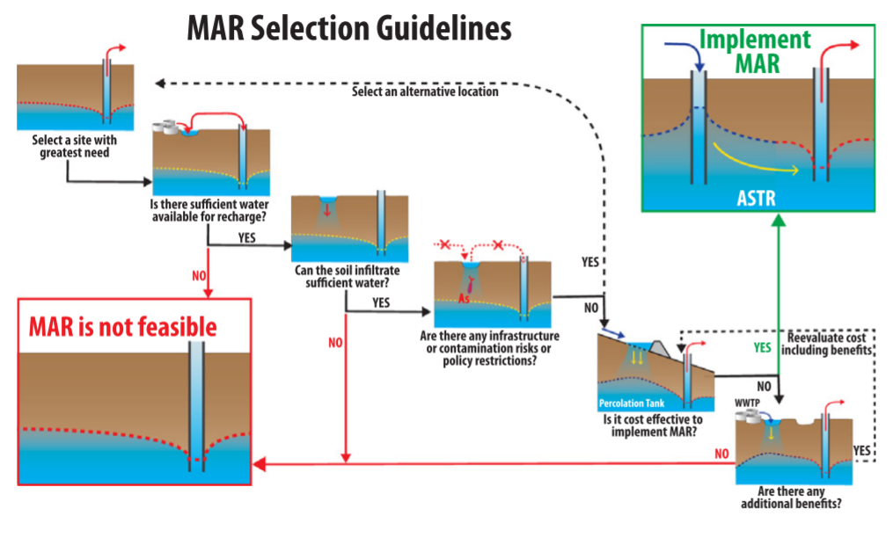
MAR Selection Guidelines
1
2
3
4
5
6
Source: Alam et al., 2021
Notes:
The slide above shows a MAR selection guide. In general, the MAR selection depends highly on soil properties, water availability, and water quality but also an understanding for the different MAR designs is necessary to make adequate decisions.
First of all it is important to look at your case study region and determine the site and its needs. What are the objectives of the planned MAR scheme? Aquifer restoration? Improvement of water quality? Increase water availability? For example, if you want to improve water supply in a region, a MAR scheme will provides maximum benefit where water demands are high and water availability is low.
Recall the seven elements of a MAR scheme. The very first elements concern capturing source water. When selecting a MAR scheme it is essential to understand the source water and its temporal variability. For instance, wastewater might be available all year around but stormwater might only be available during wet periods.
Can the soil infiltrate enough water? In general, MAR schemes are applied in sites with sandy clay loam soil.
Which pollutants can be removed in the chosen MAR schemes?
What are the estimated costs?
MAR schemes provide additional benefits such as minimizing land subsidence, flood risk mitigation, reduction of salt-water intrusion, or dilution of pollutants in groundwater. If possible, these benefits should be included into the cost assessment of a MAR scheme.
––––––––––––––––
References
Alam, S., Borthakur, A., Ravi, S., Gebremichael, M., & Mohanty, S. K. (2021). Managed aquifer recharge implementation criteria to achieve water sustainability. Science of The Total Environment, 768, 144992. doi:10.1016/j.scitotenv.2021.144992

Slide 9
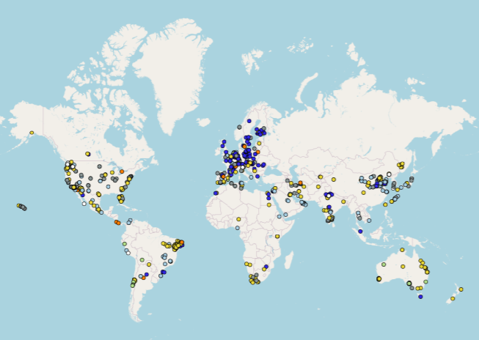
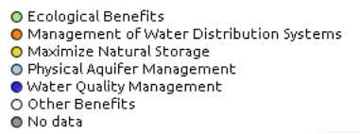
Site-specific examples: MAR Portal
Source: Stefan & Ansem, 2017/ MAR Portal.
Notes:
Site-specific selection of recharge methods
The selection of recharge methods highly depends on the geographical context and site-specific conditions in the study region (NRMMC–EPHC –NHMRC, 2009; Sprenger et al., 2017). Additionally, configuration and size of a recharge method also depends on factors like land availability, costs, compatibility with other land uses, required infiltrations rates or the thickness of the low-permeability layer (NRMMC–EPHC –NHMRC, 2009; Salameh et al., 2019). Take for example the application of a MAR system in urban areas. Land is usually expensive in urban areas and a land efficient recharge method should be selected (NRMMC–EPHC –NHMRC, 2009).
Many different MAR case studies across the globe are available. The global MAR inventory lists over 1,200 case studies from over 50 countries from Europe, Asia, Africa, North and South America, and Oceania. The map above shows site-specific examples from the MAR portal listed by main objective of the MAR projects. Link: https://www.un-igrac.org/special-project/mar-portal
––––––––––––––––
References
Dillon, P., Stuyfzand, P., Grischek, T., Lluria, M., Pyne, R. D. G., Jain, R. C., Sapiano, M. (2018). Sixty years of global progress in managed aquifer recharge. Hydrogeology Journal. doi:10.1007/s10040-018-1841-z
IGRAC (2018): MAR Portal. International Groundwater Resources Assessment Centre. Available at: https://www.un-igrac.org/special-project/marportal.
NRMMC–EPHC–NHMRC (2009): Australian Guidelines for Water Recycling, Managing Health and Environmental Risks, Volume 2C—Managed Aquifer Recharge. Natural Resource Management Ministerial Council, Environment Protection and Heritage Council National Health and Medical Research Council. Available at: http://www.ephc.gov.au/ taxonomy/term/39 (accessed: 11/09/2021).
Salameh, E., Abdallat, G., & van der Valk, M. (2019). Planning Considerations of Managed Aquifer Recharge (MAR) Projects in Jordan. Water, 11(2), 182. doi:10.3390/w11020182
Sprenger, C.; Hartog, N.; Hernández, M.; Vilanova, M.; Grützmacher, G.; Scheibler, F.; Hannappel, S. (2017): Inventory of managed aquifer recharge sites in Europe: Historical development, current situation and perspectives. Hydrogeological Journal, 25, 1909-2345. doi: 10.1007/s10040-017-1554-8
Stefan C. & Ansems N. (2017): Web-based global inventory of managed aquifer recharge applications. Sustain. Water Resour. Manag. https://doi.org/10.1007/s40899-017-0212-6

Slide 10
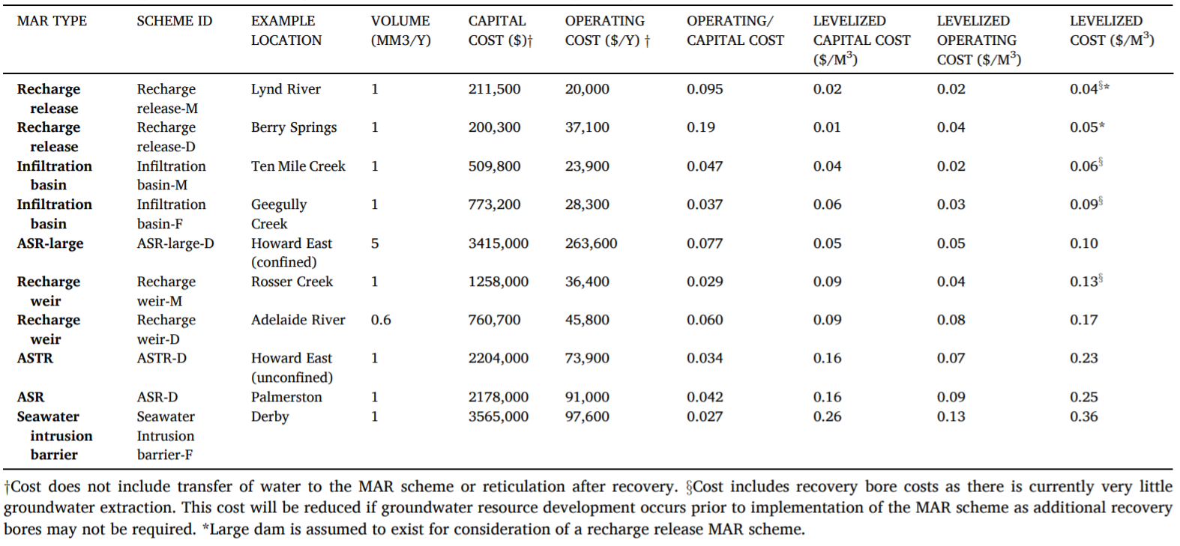
Costs – an example from Australia
Table 1: Summary of MAR scheme and indicative costs (Vanderzalm et al., 2022)
→ levelized costs ranged from US$0.04 - $0.36/m3
Notes:
How can we assess costs of MAR schemes?
The cost assessment of MAR schemes is a tricky topic because the economic aspects of MAR schemes still remains understudied. This is because the costs are highly site-specific as hydrogeological conditions influence the costs significantly. Another challenge is to estimate the monetary value of benefits provided by MAR schemes. Benefits of MAR are not only related to water security, they also include environmental and social benefits (Vanderzalm et al., 2022).
However, various case studies help to understand which components have to be considered when estimating the costs of a MAR scheme. For instance, Vanderzalm et al., 2022 estimated the costs of 10 potential MAR schemes in Northern Australia (wet-dry tropical climate) using the levelized costs approach. Levelized costs indicate the required revenue per year that is needed to recover all capital, operating and maintenance costs over the life span of a project. The concept of levelized costs is commonly used to estimate costs in the water sector and compare costs across different solutions.
They estimated a range from US$0.04 to $0.36/m3 for ten different MAR schemes with a capacity of 0.6–5 Mm3/y. One key driver of costs was the selected type of MAR scheme. In general, infiltration type schemes resulted in lower costs than schemes using injection-wells.
––––––––––––––––
References
Vanderzalm, J.; Page, D.; Dillon, P.; Gonzalez, D.; Petheram, C. (2021). Assessing the costs of Managed Aquifer Recharge options to support agricultural development. In: Agricultural Water Management, 263, doi: https://doi.org/10.1016/j.agwat.2021.107437.

Slide 11
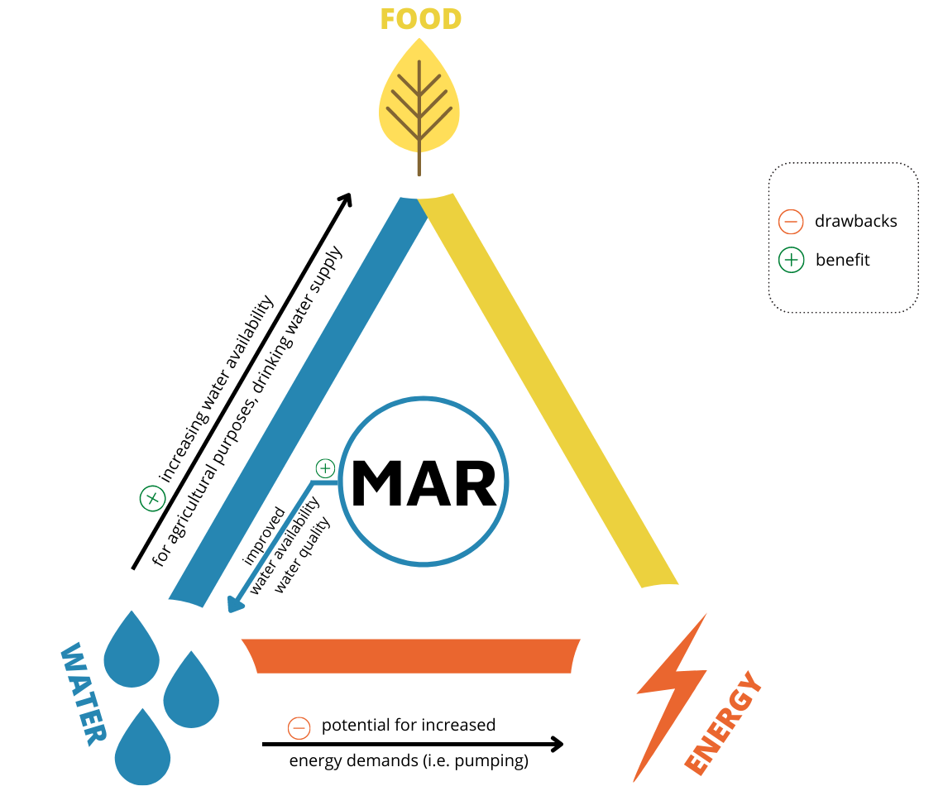
Integrating MAR into nexus systems
Figure: Alexandra Nauditt, Silvia Krautzik
Notes:
How does MAR interact with the different Nexus components?
Nexus related to MAR:
In general, MAR can help storing water for the future. This can improve security of water supply for different uses such as domestic, industrial or agricultural consumption.
Looking at MAR from a nexus-perspective, there are several intersectoral relations and feedbacks to be considered: An increase in drinking water supply might benefit food security since there are many interconnections between water, nutrition, and human health. Water is not only used for drinking but it is also essential for a safe food preparation, including washing, boiling or steaming food. At the same time, MAR can increase water availability for agricultural purposes, securing irrigation for crops that are later eaten or further processed and sold.
Energy and greenhouse gas interconnections are important factors to consider when establishing a MAR scheme. Energy is used in different stages of MAR scheme planning, implementation and operation. For instance, construction techniques and required materials for a MAR scheme should be considered as well as the use of energy efficient pumps or using gravity flows instead of pumps are also a viable option. In general, renewable energy sources might be used on the MAR site to reduce greenhouse gas emissions (NRMMC–EPHC–NHMRC, 2009).
Potential Risks
The potential synergies and trade-offs also depend on specific MAR schemes as there are so many different techniques available. For instance, when implementing infiltration basin in an area, some additional trade offs might come from land requirements, potential clogging which is a key operational challenge where untreated or incompletely treated water is recharged or the mobilization of contaminants in the soil zone due to the recharge. Moreover, the infiltration basins might favor mosquito breeding that could impact human health over time (Maliva, 2019).
––––––––––––––––
References
Maliva, R. G. (2019). Surface Spreading System—Infiltration Basins. SpringerBriefs in Electrical and Computer Engineering, 469–515. doi:10.1007/978-3-030-11084-0_15
NRMMC–EPHC–NHMRC (2009): Australian Guidelines for Water Recycling, Managing Health and Environmental Risks, Volume 2C—Managed Aquifer Recharge. Natural Resource Management Ministerial Council, Environment Protection and Heritage Council National Health and Medical Research Council. Available at: http://www.ephc.gov.au/ taxonomy/term/39 (accessed: 11/09/2021).

Slide 12
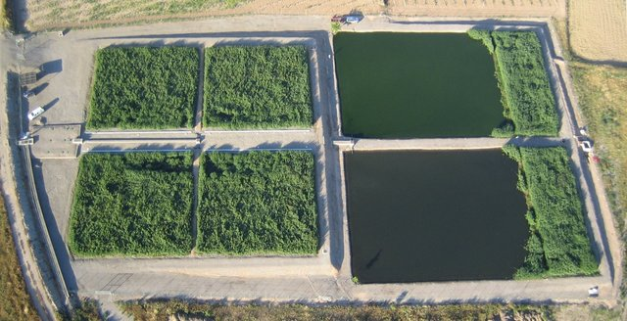
Constructed Wetlands
Source: Samso 2014 DOI:
10.13140/2.1.1666.3366
Notes:
Constructed wetlands (CWs)
CWs utilize processes that occur in natural wetlands to treat wastewaters.
From a hydrological point of view, wetlands can be categorized as
Outline

Slide 13
Constructed Wetlands
-Overview (Terminology, Relevance)
-Constructed wetlands: Function (removal mechanisms, types)
-Design and construction (categories)
-operation and maintenace
-Costs
-in sum: benefits and challenges
-trends, research, gaps
-Case study
-nexus connections
Figure: Alexandra Nauditt, Silvia Krautzik
Notes:
Introduction
Constructed wetlands are one of the most commonly implemented nature-based solution (NBS) when it comes to domestic wastewater treatment.
promising treatment options for municipal wastewater with respect to the decentralised settlements,

Slide 14
How do constructed wetlands work?
Physical processes:
Chemical processes:
Biological processes:
Notes:
Wetland systems remove pollutants based on nautral physical, biological and chemical processes. As a result, water quality is improved.
Natural wetlands are avoided because of ecosystem degradation

Slide 15
Types of constructed wetlands
three types of constructed wetlands discussed in this chapter are: 1) horizontal subsurface flow constructed wetlands, 2) horizontal free water surface flow constructed wetlands, and 3) vertical flow constructed wetlands.
Notes:
We address three main types of constructed wetlands: 1) horizontal subsurface flow constructed wetlands 2) horizontal free water surface flow constructed wetlands 3) vertical flow constructed wetlands

Slide 16
Implementation - Site-specific considerations
Location
Residental areas, odor

Slide 17
Operation and Maintenance

Slide 18
Costs

Slide 19
In a nutshell: benefits and challenges
Benefits | Challenges
 | Lack of community ownership and involvement challenges operation and maintenance of CW‘s
Mitsch et al., 2015
Notes:
References Avellan, C. T., Ardakanian, R., & Gremillion, P. (2017). The role of constructed wetlands for biomass production within the water-soil-waste nexus. Water Science and Technology, 75(10), 2237–2245. doi:10.2166/wst.2017.106

Slide 20
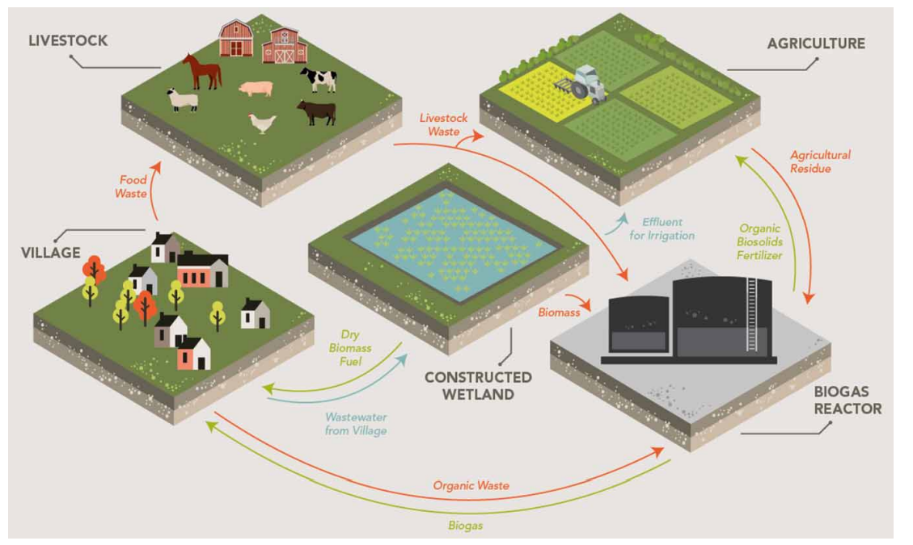
Example: integrated village waste system
Avellan et al., 2017

Slide 21
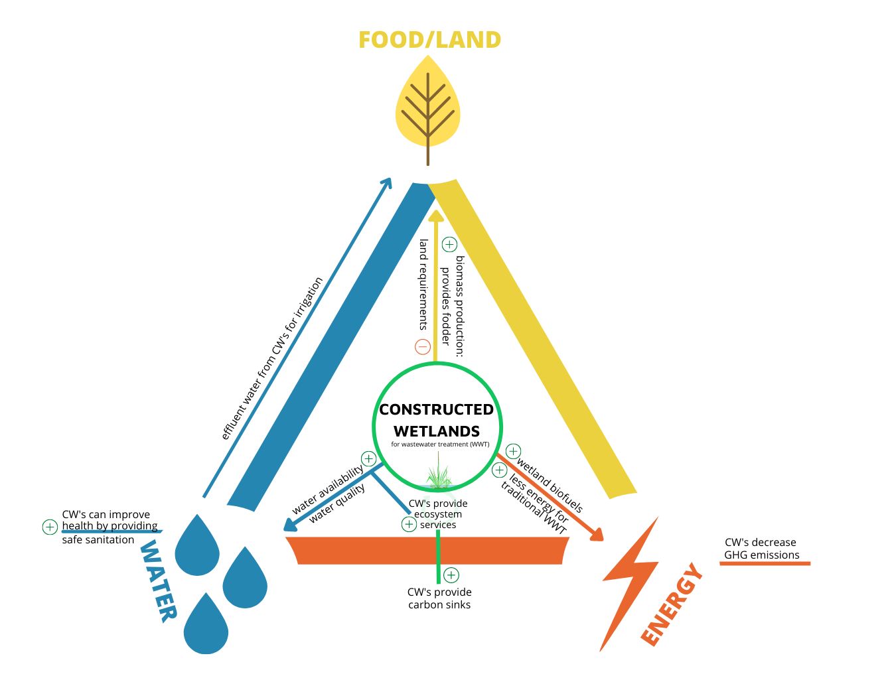
Integrating CWs into nexus systems
Figure: Silvia Krautzik
Notes:
Add: can decreases competition for crops vs. biofuel
References: Avellan, C. T., Ardakanian, R., & Gremillion, P. (2017). The role of constructed wetlands for biomass production within the water-soil-waste nexus. Water Science and Technology, 75(10), 2237–2245. doi:10.2166/wst.2017.106

Slide 22
Ecosystem services provided by CWs
Additional Materials:
Type of ecosystem service | Ecosystem: Wetlands
Provisioning Services | Fisheries support Peat production for fuel and horticulture Furbearer and other animal harvesting Timber production Direct food production
Regulating Services | Water quality improvement River flooding mitigation Protection of coastlines from tsunamis, cyclones, and other coastal storm surges Carbon sequestration Habitat for rare and endangered species
Cultural services | Landscape aesthetics Sites for human relaxation Ecology education Sustenance of human cultures Ecotourism, bird-watching
Supporting services | Wetland functions such as hydric soil development, primary productivity, serving as chemical sources, sinks, and transformers, and water storage
Mitsch et al., 2015
Notes:
References William J. Mitsch, Blanca Bernal & Maria E. Hernandez (2015) Ecosystem services of wetlands, International Journal of Biodiversity Science, Ecosystem Services & Management, 11:1, 1-4, DOI: 10.1080/21513732.2015.1006250

Slide 23
Biochar

Slide 24
Wastewater solutions in the nexus

